Slide 1
Clustering Analysis of 5512 Seismic Events in Decatur, Illinois
Ahmed Ibrahim, Research Assistant
Professor Ahmed Elbanna
Professor Sherilyn Williams-Stroud
University of Illinois at Urbana-Champaign

Slide 2
Clustering Hierarchy
The first iteration of clustering uses K-Means algorithm and spatial coordinates to cluster 5512 seismic events into 5 clusters.
The second clustering iteration uses K-Means algorithm and spatial coordinates to further subcluster clusters 1 and 2 (3990 seismic events) from the first iteration into 5 subclusters.
The third clustering iteration uses density-based clustering algorithm and spatial and temporal features to subcluster the 8 events into even smaller subclusters.

Slide 3
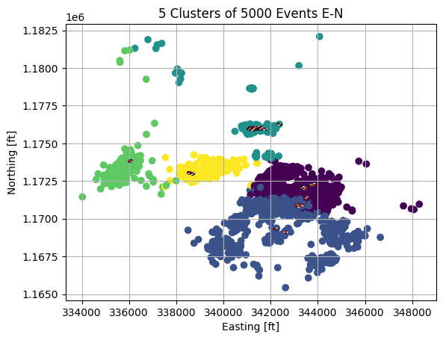
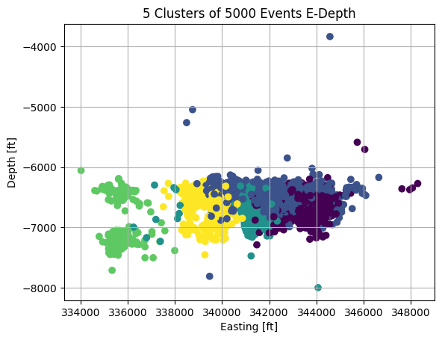
Clustering Iteration 1: Spatial Coordinates Only (K-Means)

Slide 4
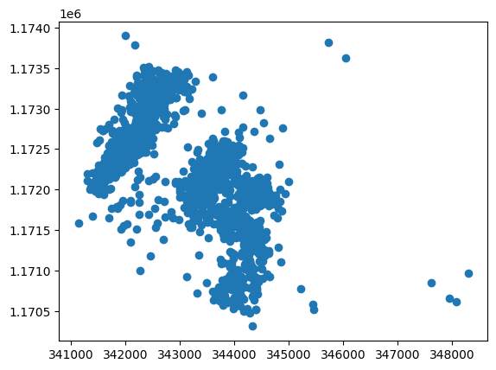
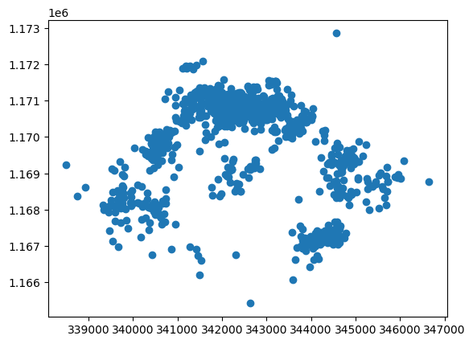
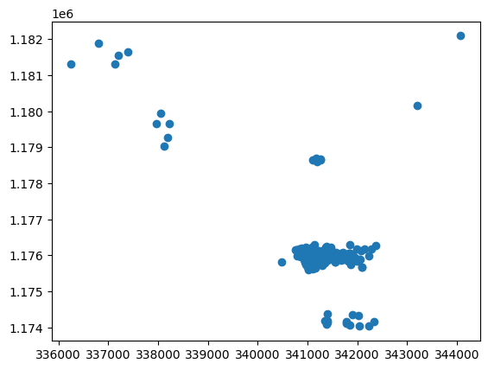
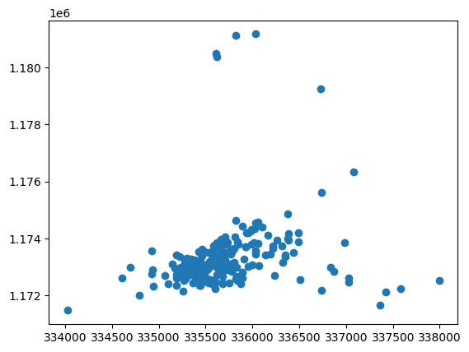
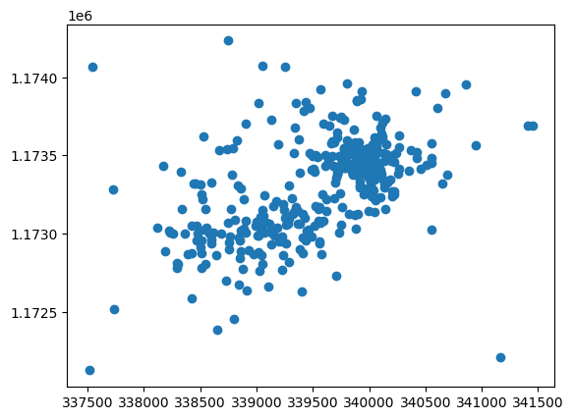
Clustering Iteration 1: Spatial Coordinates Only

Slide 5
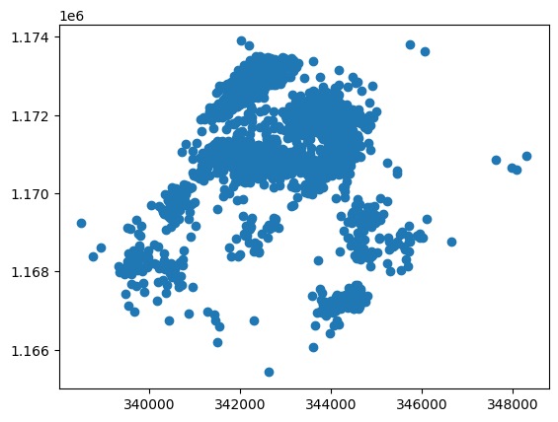
Further Clustering of Clusters 1 and 2
3990 Events

Slide 6
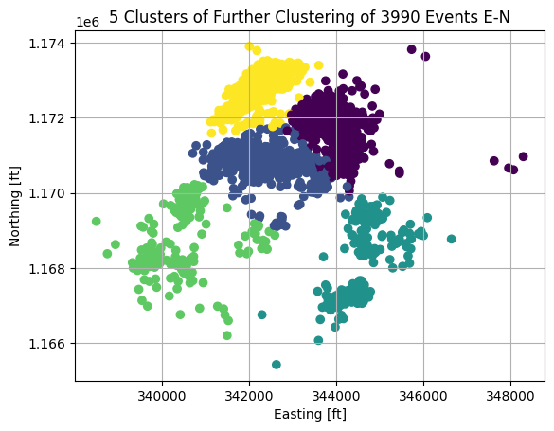
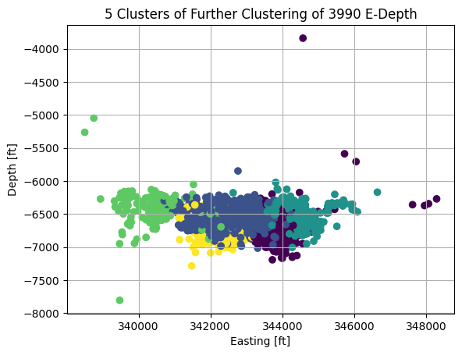
Clustering Iteration 2: Spatial Coordinates Only (K-Means)

Slide 7
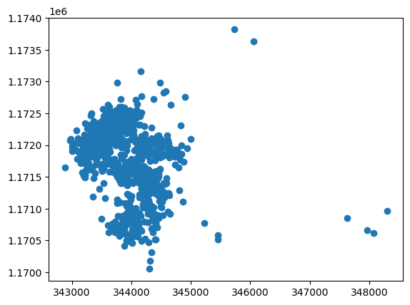
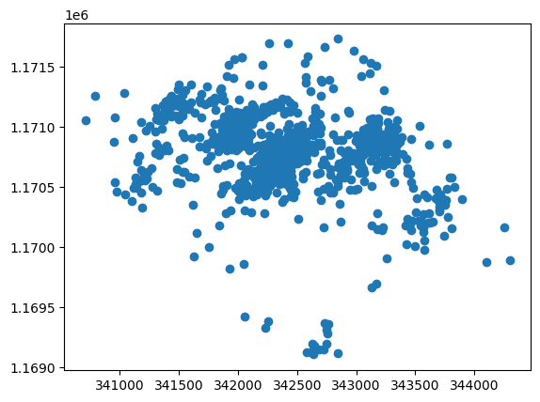
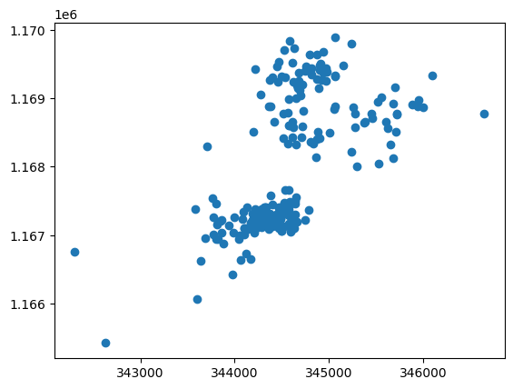
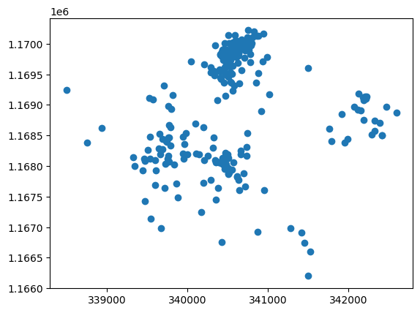
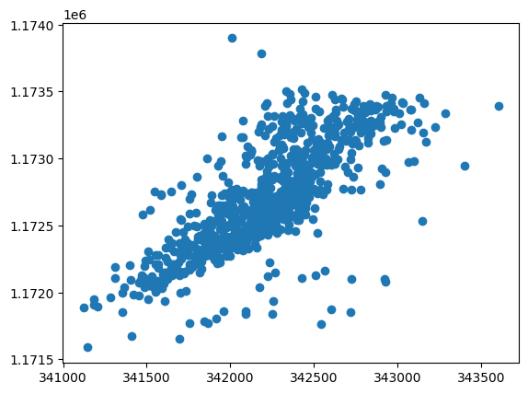
Clustering Iteration 2: Spatial Coordinates Only

Slide 8
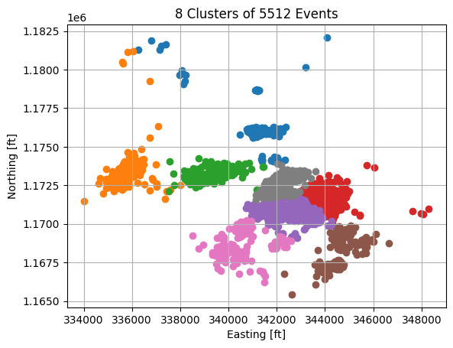
Clustering Iteration 2: Spatial Coordinates Only (K-Means)
All 5512 Events after two iterations of clustering

Slide 9
Clustering Each Cluster Using Spatial and Temporal Features

Slide 10
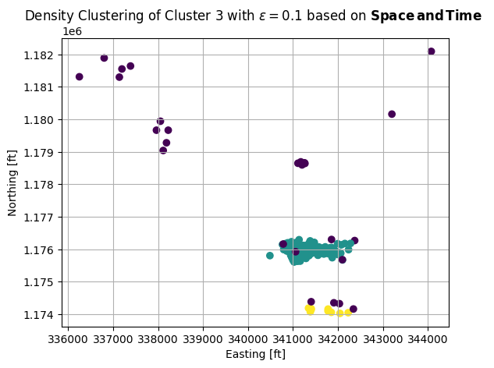
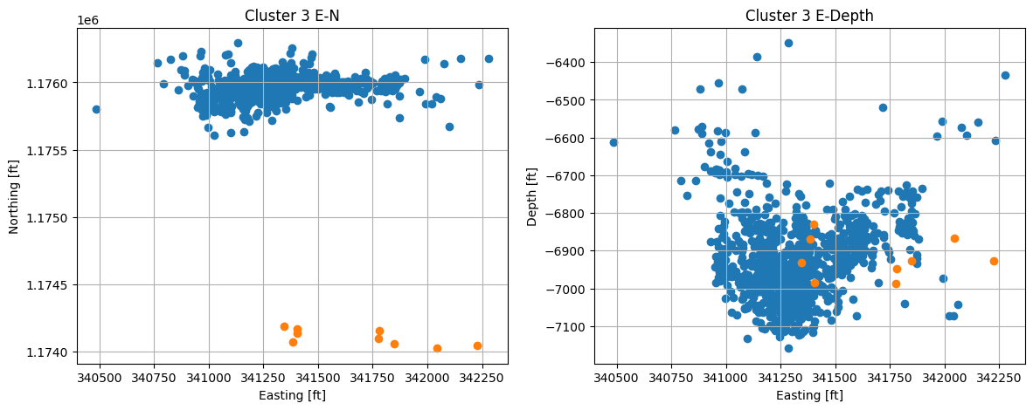
Clustering Iteration 3: Cluster 3 (DBSCAN)

Slide 11
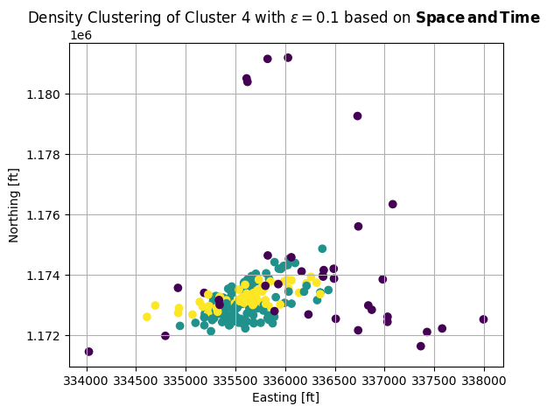
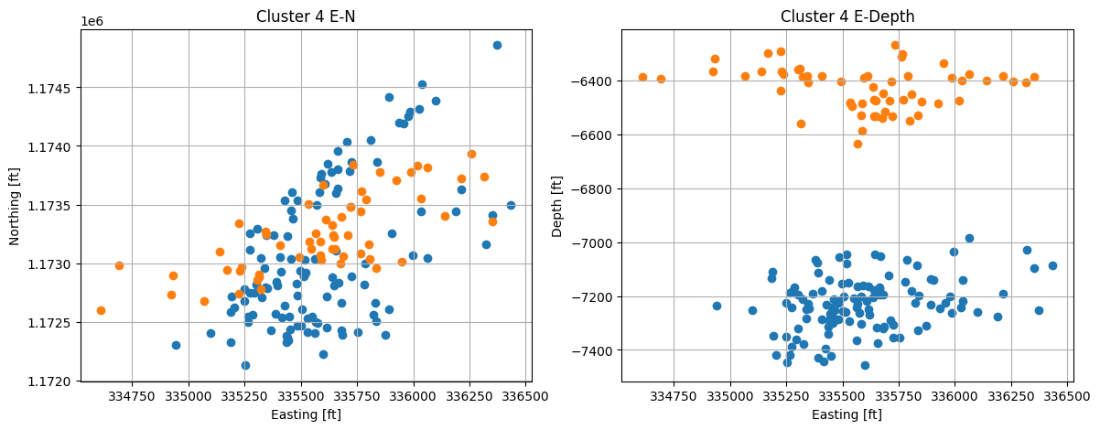
Clustering Iteration 3: Cluster 4 (DBSCAN)

Slide 12
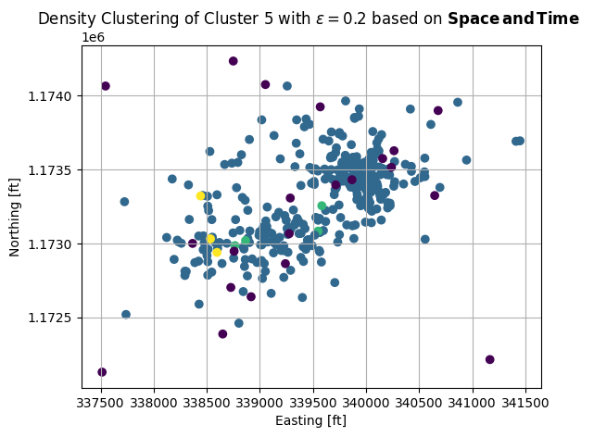
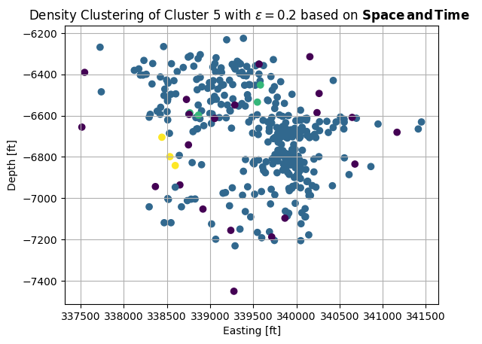
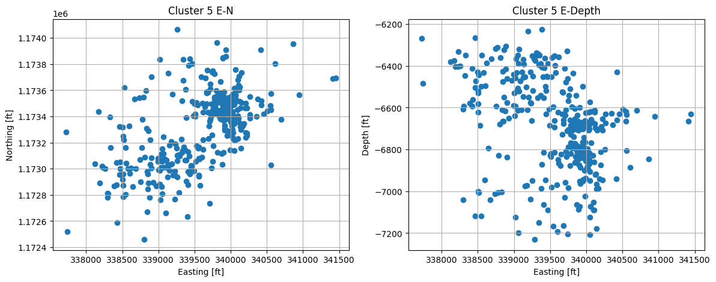
Clustering Iteration 3: Cluster 5 (DBSCAN)

Slide 13
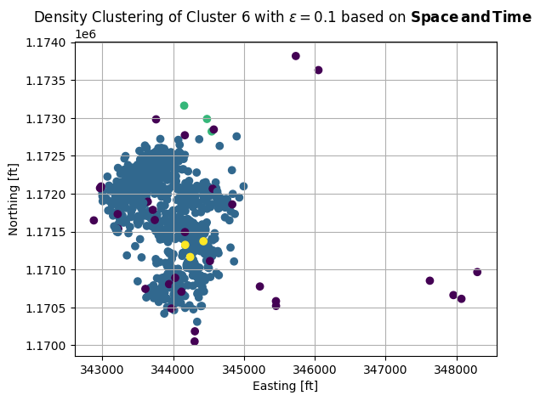
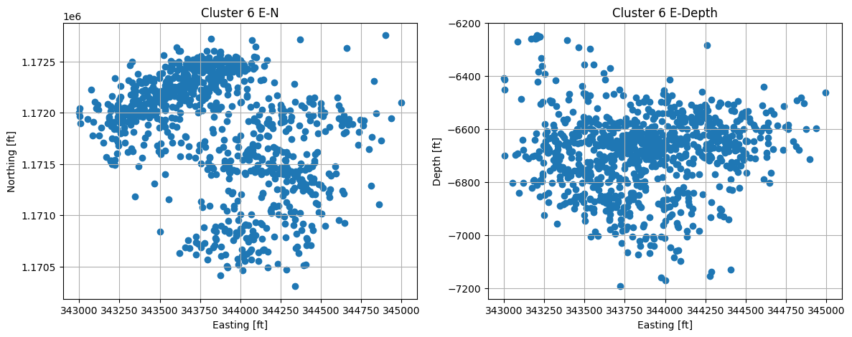
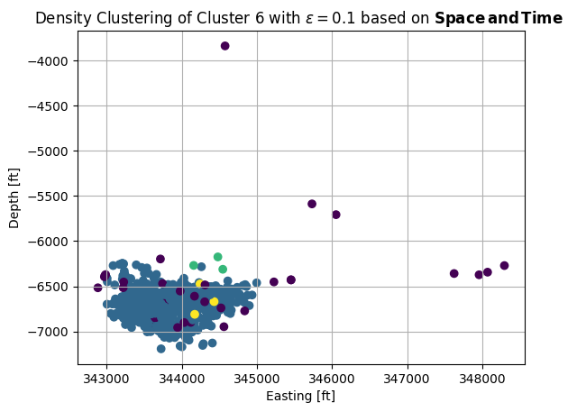
Clustering Iteration 3: Cluster 6 (DBSCAN)

Slide 14
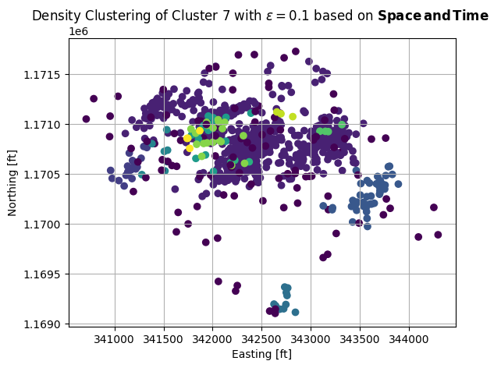
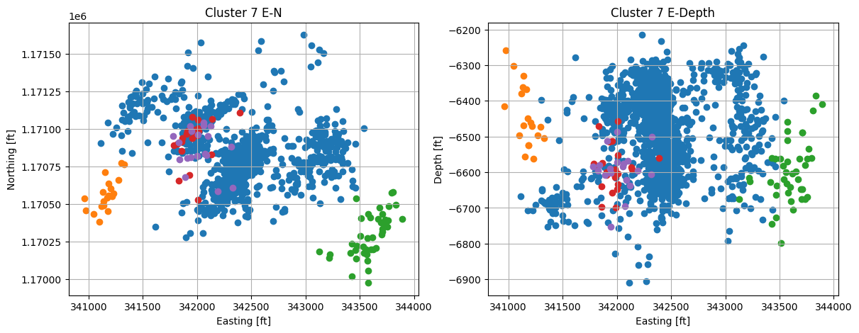
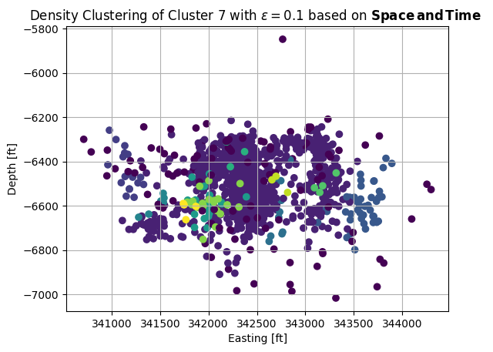
Clustering Iteration 3: Cluster 7 (DBSCAN)

Slide 15
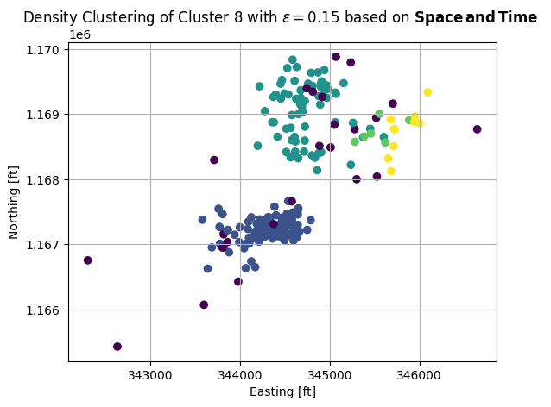
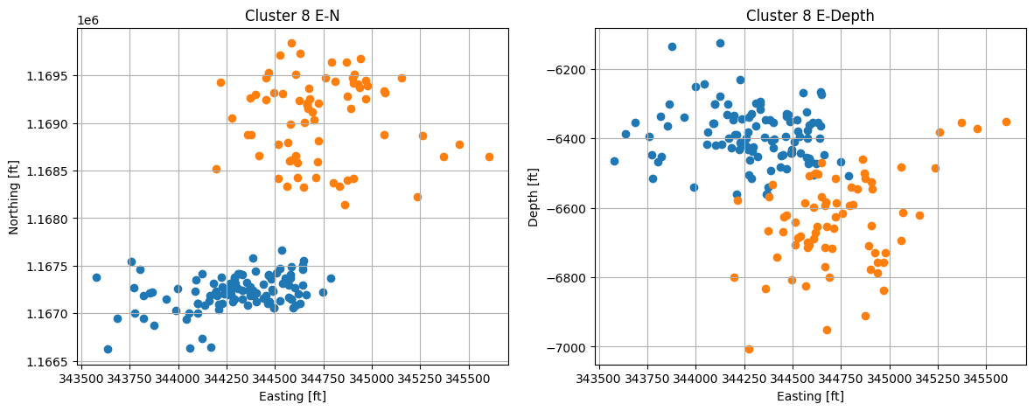
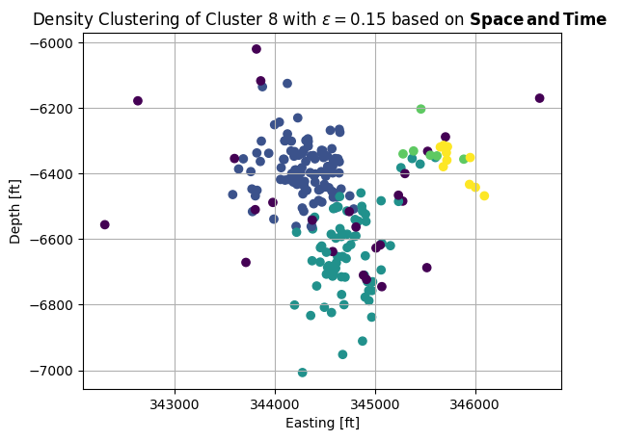
Clustering Iteration 3: Cluster 8 (DBSCAN)

Slide 16
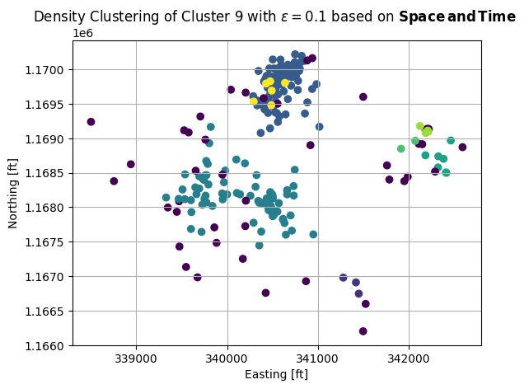
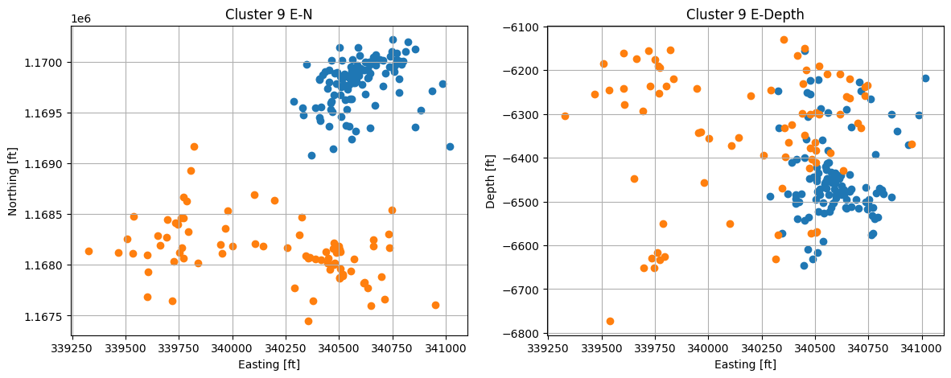
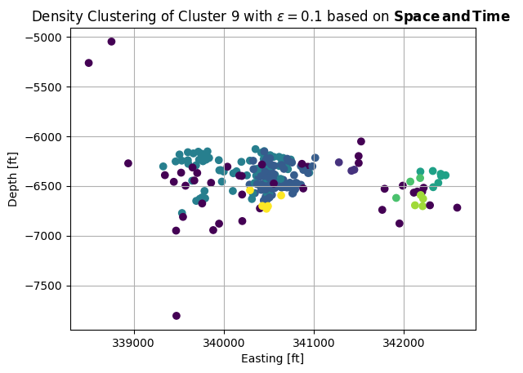
Clustering Iteration 3: Cluster 9 (DBSCAN)

Slide 17
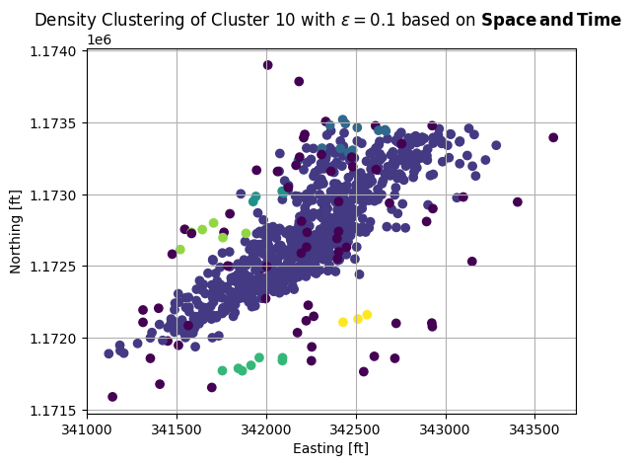
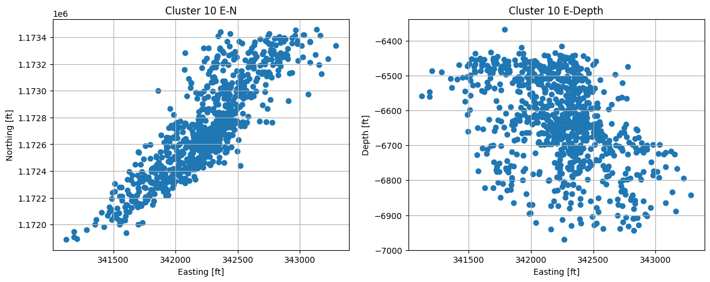
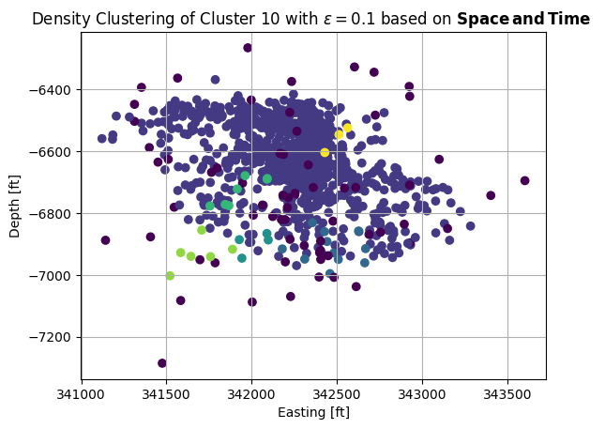
Clustering Iteration 3: Cluster 10 (DBSCAN)

Slide 18
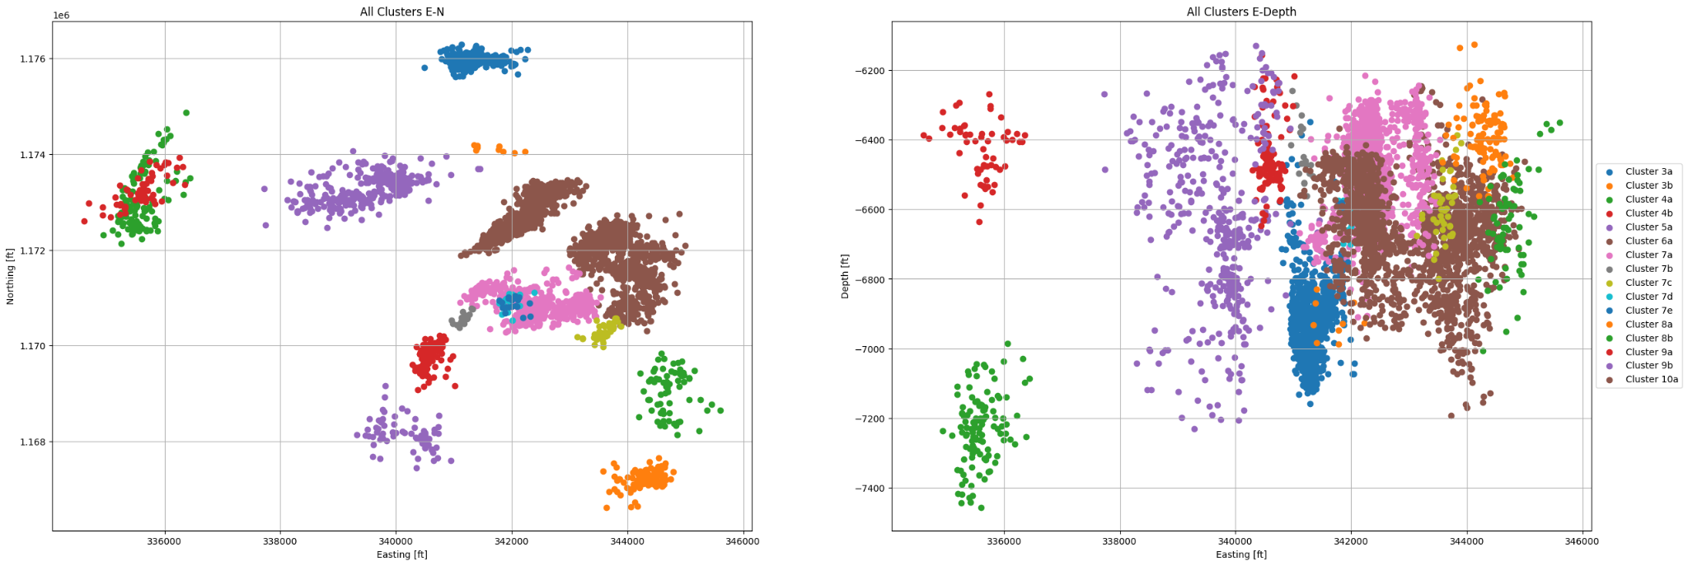
Final Clustering Results - 5040 Events - 16 Clusters

Slide 19
Fitting Fault Planes
For each identified cluster or subcluster, an additional noise removal step is performed (if needed) based on observation to enhance the accuracy of the plane fitting algorithm.
Once noise removal for each cluster is done, a plane was fitted through the set of refined 3D scatter points using least squares minimization to approximate the fault plane passing through the set of clustered points.
The relative error between the plane and 3D points is also computed for each cluster.

Slide 20
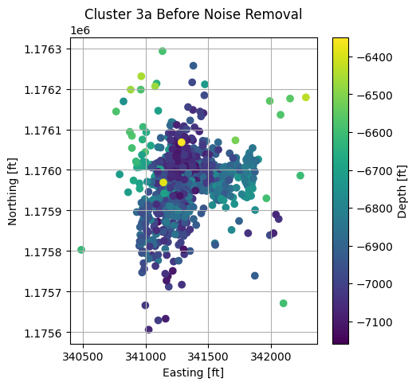
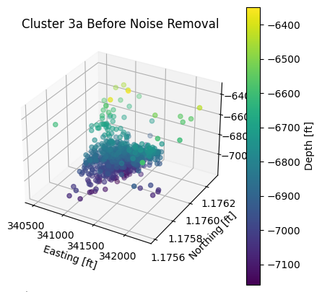
Cluster 3a - Before Noise Removal

Slide 21
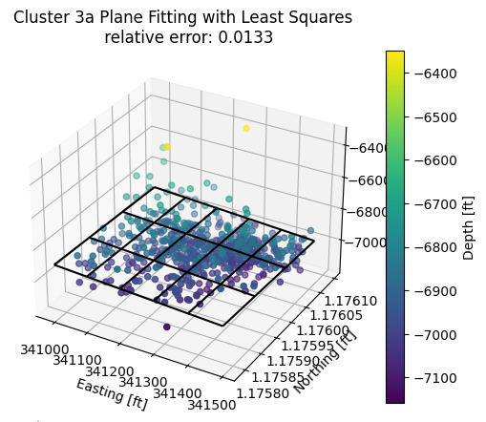
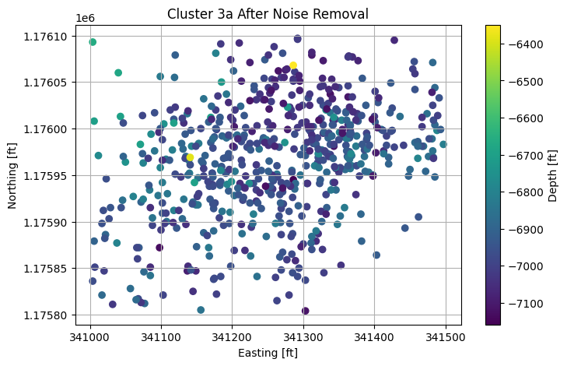
Cluster 3a - After Noise Removal

Slide 22
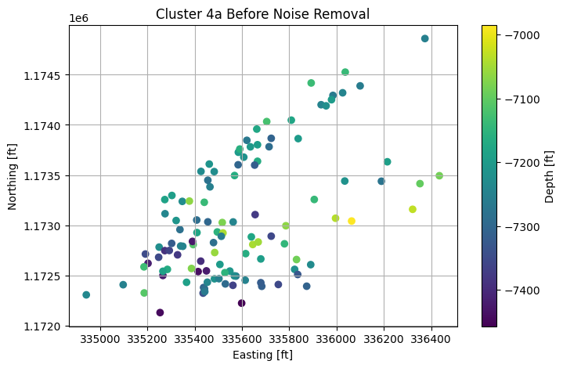
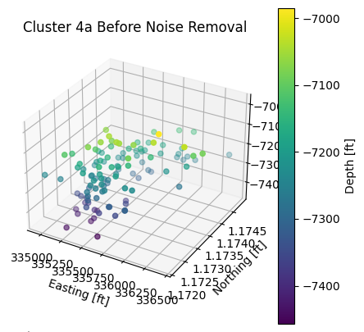
Cluster 4a - Before Noise Removal

Slide 23
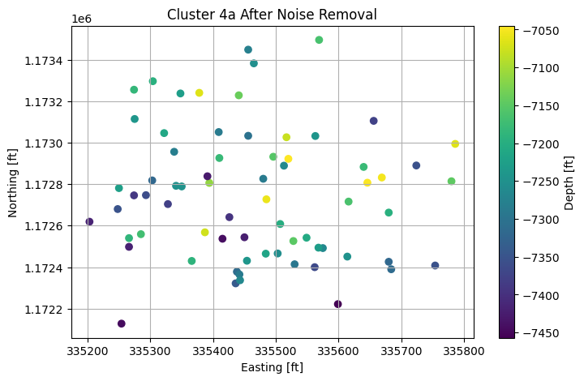
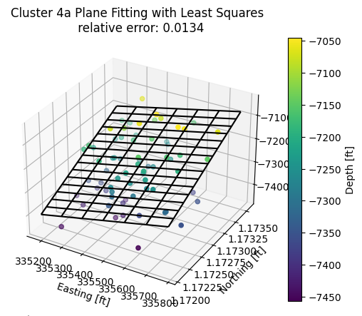
Cluster 4a - After Noise Removal

Slide 24
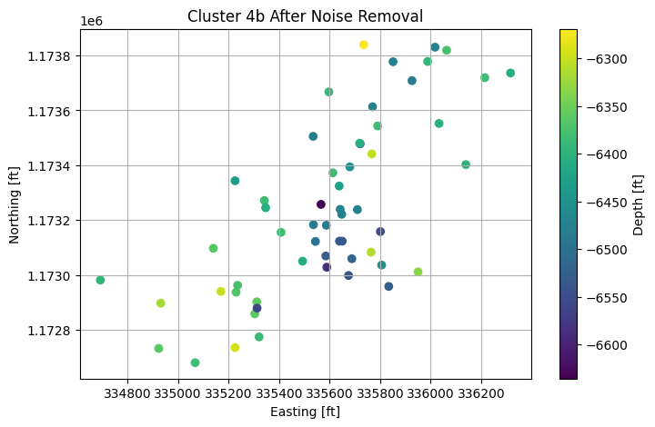
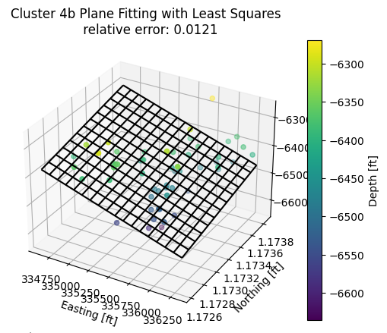
Cluster 4b

Slide 25
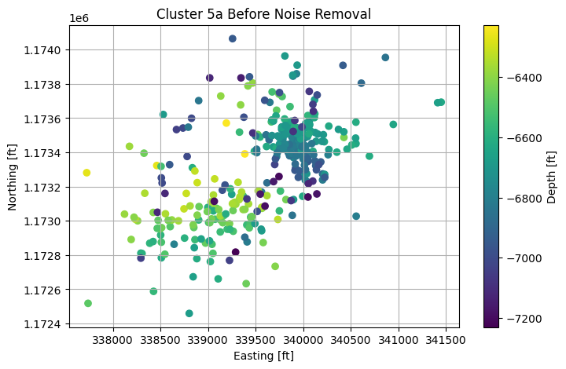

Cluster 5a - Before Noise Removal

Slide 26


Cluster 5a - After Noise Removal

Slide 27


Cluster 6a - Before Noise Removal

Slide 28




Cluster 6a - After Noise Removal

Slide 29


Cluster 7a - Before Noise Removal

Slide 30








Cluster 7a - After Noise Removal

Slide 31


Cluster 7b

Slide 32


Cluster 7c - Before Noise Removal

Slide 33


Cluster 7c - After Noise Removal

Slide 34


Cluster 7d - Before Noise Removal

Slide 35


Cluster 7d - After Noise Removal

Slide 36


Cluster 7e - Before Noise Removal

Slide 37


Cluster 7e - After Noise Removal

Slide 38


Cluster 8a - Before Noise Removal

Slide 39


Cluster 8a - After Noise Removal

Slide 40


Cluster 8b - Before Noise Removal

Slide 41


Cluster 8b - After Noise Removal

Slide 42


Cluster 9a - Before Noise Removal

Slide 43


Cluster 9a - After Noise Removal

Slide 44


Cluster 9b - Before Noise Removal

Slide 45


Cluster 9b - After Noise Removal

Slide 46


Cluster 10a

Slide 47

Computing Focal Mechanisms of Clusters based on Known Focal Mechanisms

Slide 48
Methodology
New focal mechanisms (FM) are computed based on known FMs from SLB.
For each noise-free cluster, if a single known focal mechanism falls within the cluster based on a distance threshold, all seismic events assume the same known FM and fault plane is computed based on the single FM.
IF more than one known FM falls within a cluster, new FMs of seismic events are interpolated/extrapolated from known FMs.
Once interpolated, the cluster is further sub-clustered using density-based clustering and interpolated FMs. Finally, fault planes are computed for each subcluster based on the average subcluster FM.

Slide 49


Cluster 3a

Slide 50

Cluster 4a

Slide 51

Cluster 4b

Slide 52

Cluster 5a

Slide 53

Cluster 6ai

Slide 54

Cluster 6aii

Slide 55

Cluster 7ai

Slide 56

Cluster 7aii

Slide 57

Cluster 7aiii

Slide 58

Cluster 7aiv

Slide 59

Cluster 7c

Slide 60

Cluster 7d

Slide 61

Cluster 7e

Slide 62

Cluster 8a

Slide 63

Cluster 8b

Slide 64

Cluster 9a

Slide 65

Cluster 9b

Slide 66

Cluster 10a

Slide 67

New and Known Focal Mechanisms
Blue beachballs are newly identified FM
Red beachballs are known FM from SLB

Slide 68

Focal Mechanisms Along with Seismic Clusters
Blue beachballs are newly identified FM
Red beachballs are known FM from SLB

